Slide 1
Handcrafting a Network to Predict Next Token Probabilities for the Random-Random-XOR Process
Rick Goldstein
Computational Mechanics Hackathon
Organized by Adam Shai, Paul Riechers, PIBBSS

Slide 2
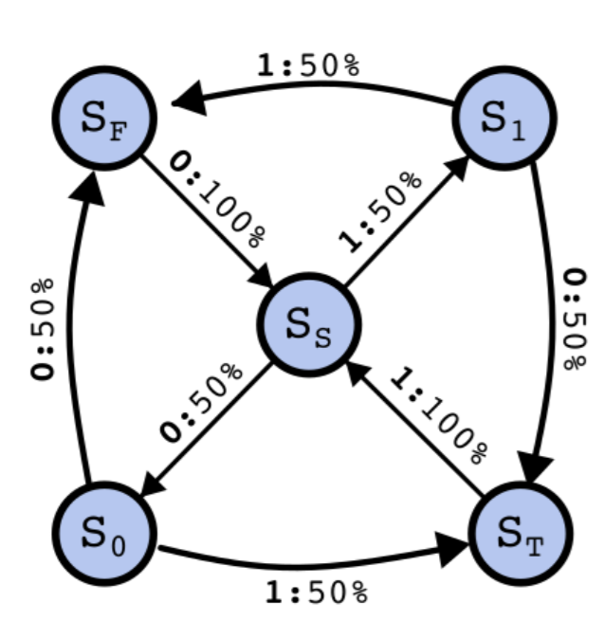
Background: Random-Random-XOR Process
Hidden Markov Model
Can’t directly Observe the State
Don’t know Start Location
From center state:
Random bit
Random bit
XOR of last two bits
Period 3
Simplex has trained a network on this HMM; 36 possible full state beliefs
Random-Random-XOR HMM

Slide 3
What + Why
Handcraft network weights to calculate probabilities for next token for Random-Random-XOR HMM
Think about features that trained model might be calculating
Replace hard-to-understand model components with easy-to-understand components
Random-Random-XOR HMM

Slide 4
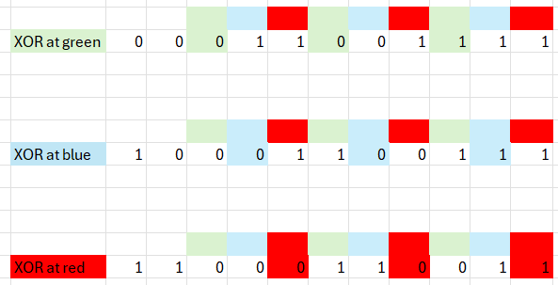

Notion of XOR violations
Process has period 3
Since we don’t know initial state of model, don’t know if the XOR will occur at green, blue, or red, but it must occur at one of them
Handcrafted features deal with figuring out which locations are possible (not blue)
Then use Bayesian stats to determine how likely it is next token must be XOR

Slide 5
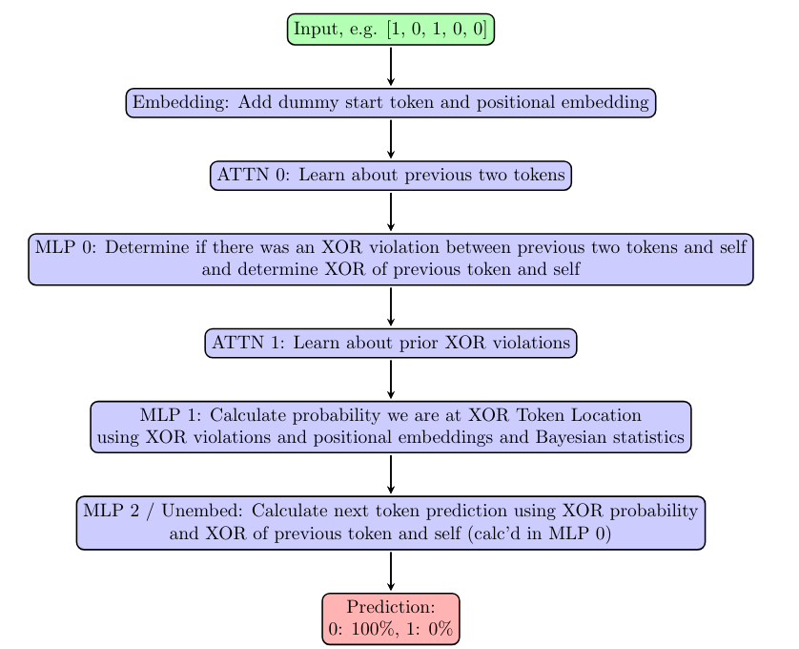
Handcrafted Model Architecture/Logic
Take current partial rollout
Previous 2 Token info shared
Local XOR violations calculated
XOR violations shared
Bayesian stats to predict next token
Guess probabilities for next token

Slide 6
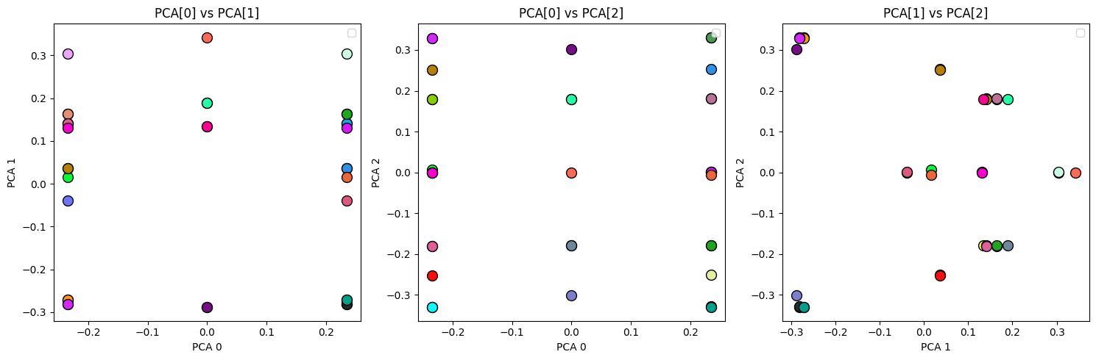
Other Work (Quick)
Compared against simulator to confirm calculations
Ambiguous results from regression → PCA plotting

Slide 7
Conclusion
Main takeaway
Maybe we don’t need full belief state?
Just need a few important features
Future work
Try to interpret trained network

Slide 8
Handcrafting a Network to Predict Next Token Probabilities for the Random-Random-XOR Process
Rick Goldstein
Computational Mechanics Hackathon
Organized by Adam Shai, Paul Riechers, PIBBSS

